Slide 1
Data Link Layer HDLC and IEEE Frames
Lecture 01

Slide 2
Content
High-level Data Link Control (HDLC)
The reference model of data link layer protocols
Data Link Layer Standards
ISO/IEC 8802-2 (IEEE 802.2 obsoleted)
Logical Link Control Sublayer
IEEE 802-2014
IEEE Standard for Local and Metropolitan Area Networks: Overview and Architecture

Slide 3
Data Link Layer Data Link Layer fundamental functions
Frame
The unit of data to be sent by a DLL protocol
Addressing
Identifying an entity on the DLL network
Data transfer
Media Access Control
Controlling the transmission of the frames
Flow control
Controlling the transmission speed of a sender
Error control
Detecting and correcting transmission errors
Management
Maintaining the data link layer

Slide 4
Data Link Layer Protocols
High-level Data Link Control (HDLC) the reference model of data link layer protocols

Slide 5
Data Link Layer Protocols High-level Data Link Control (HDLC)
The HDLC is based on IBM's Synchronous Data Link Control (SDLC) protocol, which is the layer 2 protocol for IBM's Systems Network Architecture (SNA).
Synchronous Data Link Control (SDLC) was originally designed to connect one computer with multiple peripherals

Slide 6
Data Link Layer Protocols High-level Data Link Control (HDLC)
A bit-oriented code-transparent synchronous data link layer protocol developed by ISO
The original standards for HDLC
ISO 3309 – Frame Structure
ISO 4335 – Elements of Procedure
ISO 6159 – Unbalanced Classes of Procedure
ISO 6256 – Balanced Classes of Procedure
The current standard for HDLC is ISO 13239

Slide 7
Data Link Layer Protocols High-level Data Link Control (HDLC)
HDLC services
Connection-oriented service
(Reliable) in-sequence frame delivery
Flow Control
Controlling the sender’s Tx speed by the receiver
(point-to-multipoint) in turn
(point-to-point) flow control
Error Control
Frames with errored bits: FCS (CRC)
Lost frames: Frame sequence and retransmission timer
Connectionless service
No guarantee for the frame delivery

Slide 8
Data Link Layer Protocols High-level Data Link Control (HDLC)
HDLC operation mode
(point to multipoint connections)
Master-slave mode
Normal Response Mode (NRM)
Asynchronous Response Mode (ARM)
(point-to-point mode)
Peer-to-peer mode
Asynchronous Balanced Mode (ABM)

Slide 9
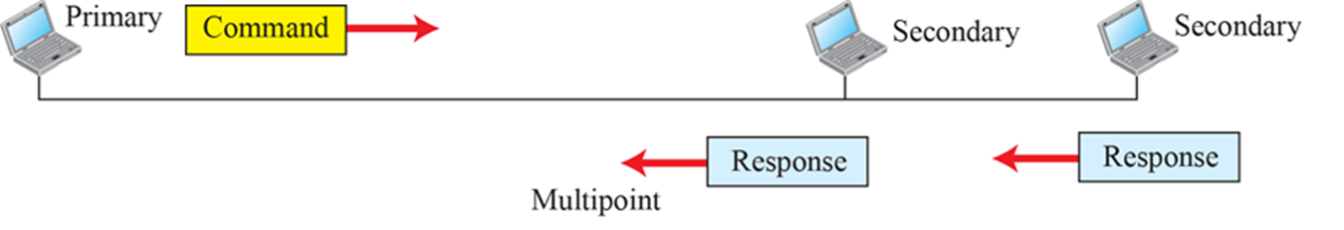
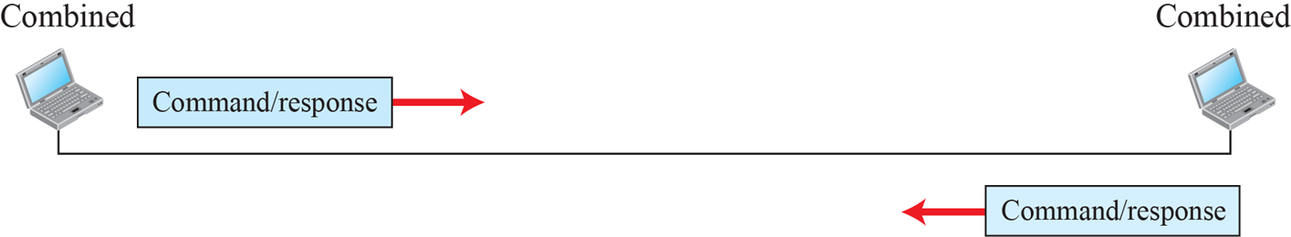
Data Link Layer Protocols HDLC Operation Mode
Receiver
Sender
NRM/NRME (normal response extended mode)
ARM/ARME (asynchronous response extended mode)
Unbalanced, which consists of one primary terminal, and one or more secondary terminals.
ABM/ABME (asynchronous balanced extended mode)
Receiver/Sender
Balanced, which consists of two peer terminals.
Extended mode : 7-bit sequence number in the control field

Slide 10
Data Link Layer Protocols HDLC Operation Mode
Normal Response Mode (NRM)
The computer gives each peripheral permission to speak in turn
Commands and responses are indistinguishable
The only difference is the direction in which they are transmitted
Normal response mode allows operation over half-duplex communication links

Slide 11
Data Link Layer Protocols HDLC Operation Mode
Asynchronous Response Mode (ARM)
Master-slave mode
It allows operation over full-duplex communication links
It allows the slave computer to transmit at any time

Slide 12
Data Link Layer Protocols HDLC Operation Mode
Asynchronous balanced mode (ABM)
The concept of a combined terminal which can act as both a primary and a secondary.
The address field of a received frame must be examined to determine [whether it contains a command or a response].
If the address = mine, command
Otherwise, response

Slide 13
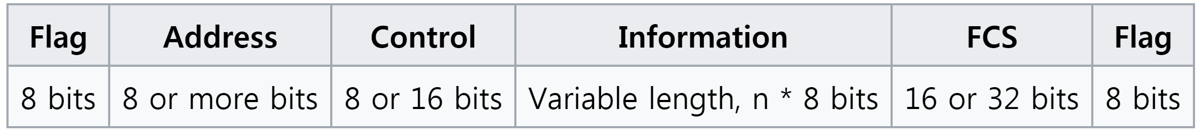

Data Link Layer Protocols HDLC Frame structure
Flag : Start/end frame delimiter (0x7E)
Address
Command : receiver’s address, Response: the sender’s address
Control
HDLC control information including frame type
8 bits : normal mode (use 3-bit sequence number)
16 bits: extended mode (use 7-bit sequence number)
FCS (Frame Check Sequence)
16 bits : CRC-CCITT;
32 bits : CRC-32;

Slide 14
Data Link Layer Protocols HDLC Framing
HDLC frames can be transmitted over synchronous or asynchronous serial communication links.
‘0x7E’ is used to delimiter frames
Synchronous serial communication link
Sending empty frames even if there is no data available to be sent
Asynchronous serial communication link
No frame is sent if there is no data available to be sent

Slide 15

Data Link Layer Protocols HDLC Framing: Synchronous link
When no frames are being transmitted on a simplex or full-duplex synchronous link, a frame delimiter (0x7E) is continuously transmitted on the link

Slide 16
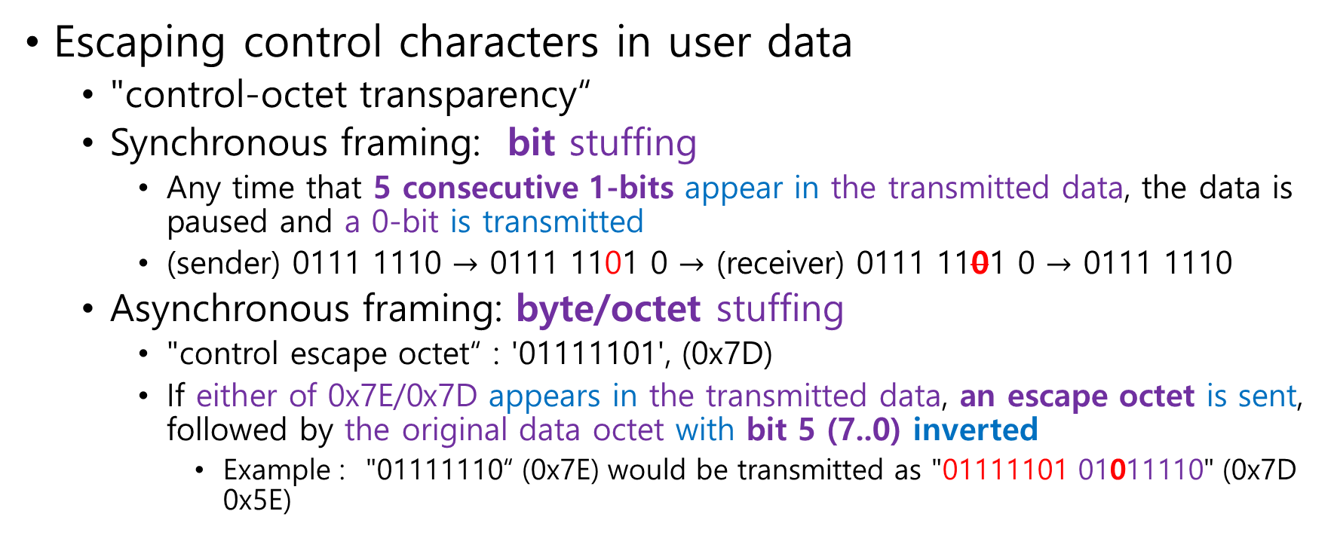
Data Link Layer Protocols HDLC Framing
Escaping control characters in user data
"control-octet transparency“
Synchronous framing: bit stuffing
Any time that 5 consecutive 1-bits appear in the transmitted data, the data is paused and a 0-bit is transmitted
(sender) 0111 1110 $→$ 0111 1101 0 $→$ (receiver) 0111 1101 0 $→$ 0111 1110
Asynchronous framing: byte/octet stuffing
"control escape octet“ : '01111101', (0x7D)
If either of 0x7E/0x7D appears in the transmitted data, an escape octet is sent, followed by the original data octet with bit 5 (7..0) inverted
Example : "01111110“ (0x7E) would be transmitted as "01111101 01011110" (0x7D 0x5E)

Slide 17
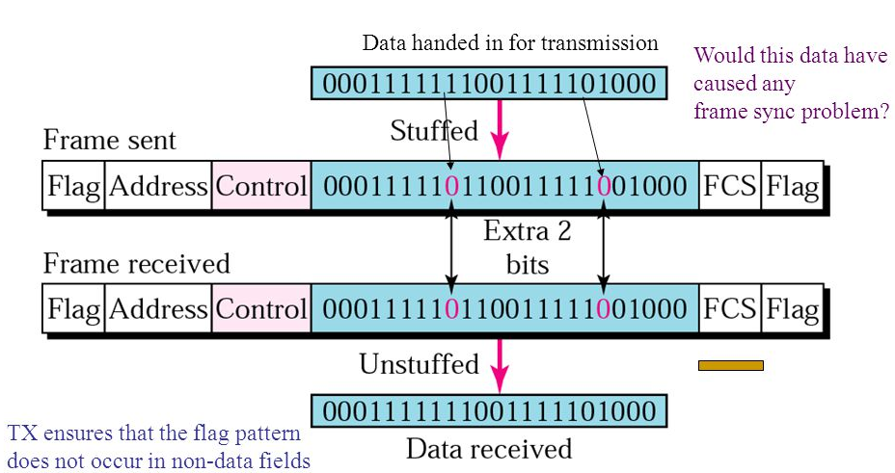
Data Link Layer Protocols HDLC Framing: Bit Stuffing

Slide 18
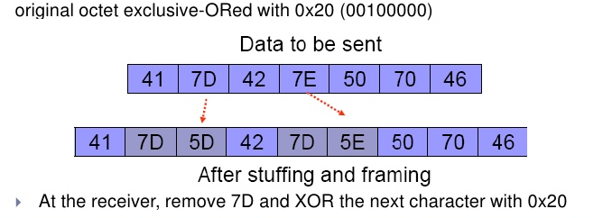
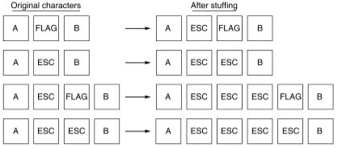
Data Link Layer Protocols HDLC Framing: Byte Stuffing

Slide 19
Data Link Layer Protocols HDLC Frame Types
Information frames (or I-frames)
User Information frame for connection-oriented service
Supervisory Frames(or S-frames)
Control frame for flow and error control
It is used whenever piggybacking the control information is impossible or inappropriate.
Unnumbered frames(or U-frames)
Various miscellaneous purposes
Link management frame
User Information frame (UI frame) for connectionless service

Slide 20
Data Link Layer Protocols HDLC Frame Types
Common frame types at the data link layer
Control Frame
Controlling data frame transfer
HDLC: Supervisory Frames (they can be piggybacked at the I-frames)
Data Frame
Containing user date to be transferred.
HDLC: Information frames or UI (Unnumbered Information) frame
Management Frame
Maintaining a connection (or an association) between peer nodes
Establishing/tearing down a connection
Negotiating optional configurations or functions between peer nodes
HDLC: Unnumbered frames except UI frames

Slide 21
Data Link Layer Protocols HDLC Control Field
Contents of the HDLC Control Field depend on a frame type.
Supervisory Frames
The status of the data frame delivery operation
Information frames
I-frames: the current data position for the sending data stream (connection-oriented).
If an S-frame is piggybacked, the current data position of the received data stream
UI-frame: no status information (connectionless)
Management Frame
The type of Management frames

Slide 22
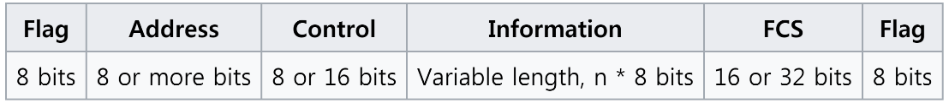
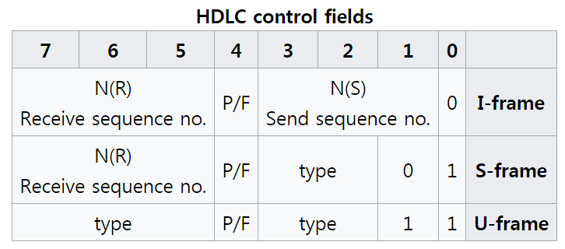
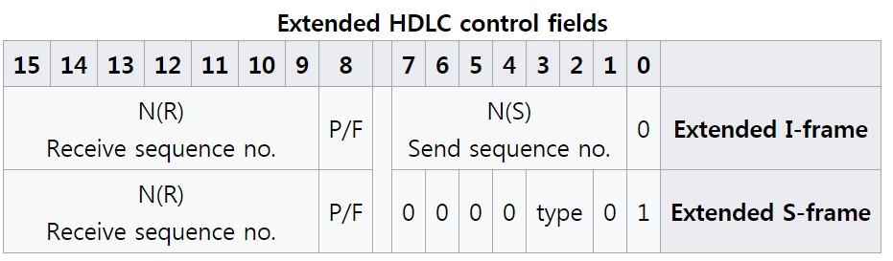
Data Link Layer Protocols HDLC Control Field
LSB
LSB
Transmission direction: LSB (bit0) first
The P/F bit
Poll/Final is a single bit with two names.
Poll (command) : when set by the primary station to obtain a response from a secondary station
Final (response) : when set by the secondary station to indicate a response or the end of transmission.
In all other cases, the bit is clear.

Slide 23
Data Link Layer Protocols HDLC Control Field
The P/F bit
The bit is used as a token [that is passed back and forth between the stations].
The primary station sets the POLL to obtain a response from a secondary station
The secondary station only sets the FINAL to indicate the end of transmission.
Only one token should exist at a time.
The primary only sends a Poll when it has received a Final back from the secondary, or after a timeout indicating that the bit has been lost

Slide 24
Data Link Layer Protocols HDLC Connection Management (U-Frame)
A connection initialization can be requested by either side
A station sends a ‘set’ (U-frame) specifying the operation mode to the other side
(NRM, ARM, ABM)
Specifies 3-bit sequence numbers are in use
NRME, ARME, ABME (Extended mode)
Specifies 7-bit sequence numbers are in use
The other responses with ‘Unnumbered Acknowledgement’ (UA; U-frame)

Slide 25
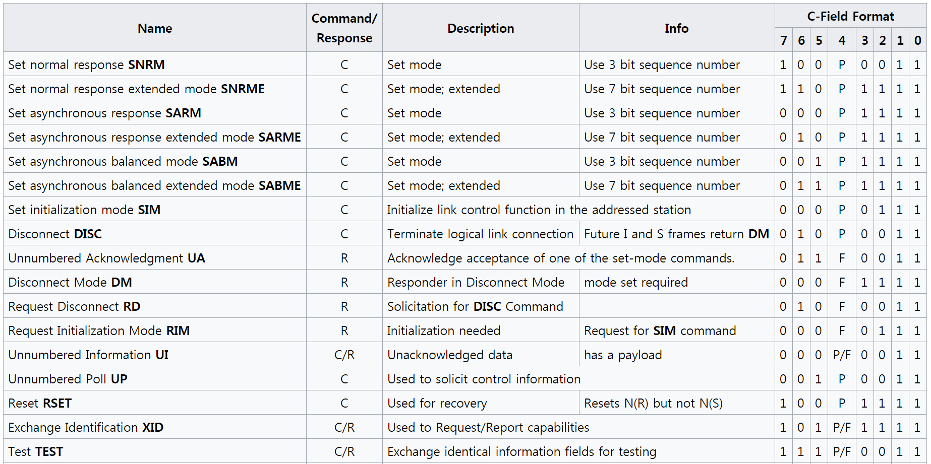
Data Link Layer Protocols HDLC Connection Management (U-Frame)
Connection initialization/termination

Slide 26
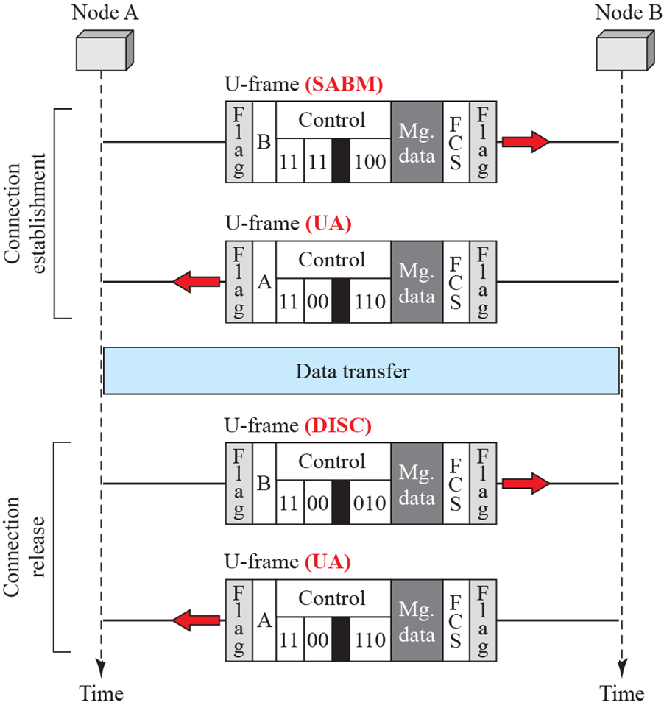
Data Link Layer Protocols HDLC Connection Establishment and termination

Slide 27
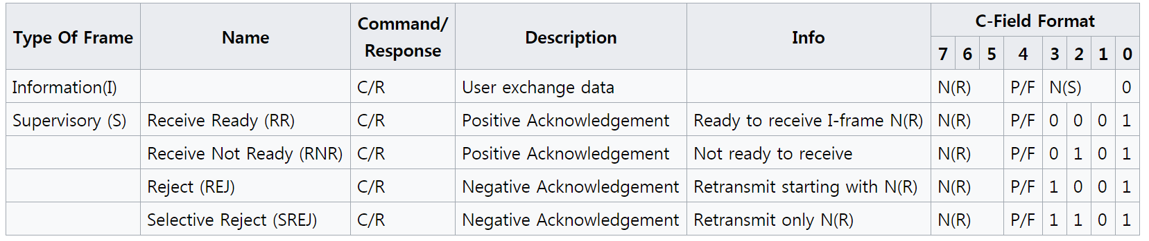
Data Link Layer Protocols HDLC S-frame
Connection oriented service : User data
S-Frame: (bit1..bit0:[01])
S-frame subtype: (bit3..bit2) – used for Flow Control and Error Control
RR(00): the frame N(R) is expected (N(R)-1 is received), and the sender may send new frame
RNR(01): the frame N(R) is expected (N(R)-1 is received), but the sender is prohibited to send new frame until new S-frame with (RR) is arrived.
REJ(10): the frame N(R) is in error (corrupted or lost): see flow-control ppt
the sender retransmits frames from N(R) to the last transmitted frame
SREJ(11): the frame N(R) is in error (corrupted or lost): see flow-control ppt
the sender retransmits the frame N(R)

Slide 28
Data Link Layer Protocols HDLC I-frame
Connection oriented service : User data
I-Frame
It is used to transfer user information of a connection-oriented service
N(R): the frame N(R) is expected from the other side.
Eliminating a S-frame with RR (N(R))
N(S): the sequence number of the transmitting frame

Slide 29
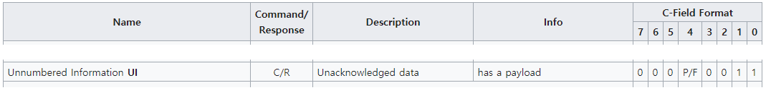
Data Link Layer Protocols HDLC UI-frame
UI-frame
(U-frame (bit1..bits0(11)); subtype(bit7..bit5, bit3..bit2(000 00)): Information)
It is used to transfer user information for connectionless service
The connectionless service does not need the P/F field, the sequence number field as well as S-frame.
C-Field (bit7..bit1(0000 0011; 0x03)

Slide 30
Data Link Layer Standards
IEEE 802-2014
ISO/IEC 8802-2 (IEEE 802.2 obsoleted)

Slide 31
IEEE 802-2014 Data Link and Physical Layers
IEEE Standard for Local and Metropolitan Area Networks: Overview and Architecture

Slide 32
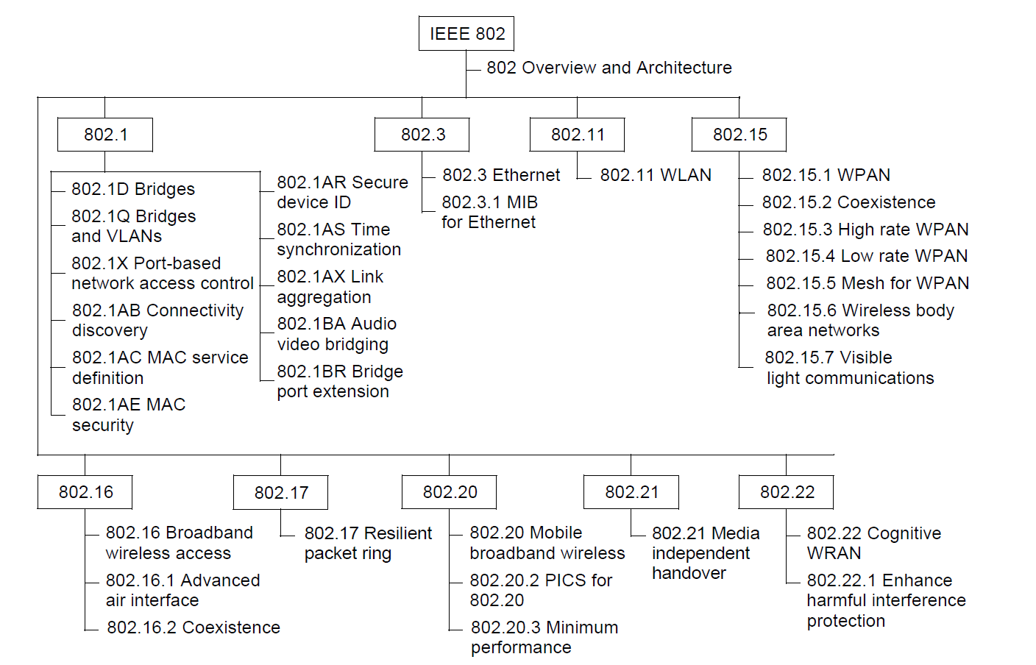
IEEE 802-2014 Current family of IEEE 802 standards

Slide 33
Data Link Layer Standards
IEEE 802-2014
Overview and Architecture
ISO/IEC 8802-2 (IEEE 802.2)
Logical Link Control
IEEE 802.1AC-2016 (the Internal Sublayer Services)
Medium Independent Access Control(MAC) - ISS
IEEE 802.3-2022 Ethernet
Medium Access Control for Ethernet
IEEE 802.11-2020 WLAN
Medium Access Control for Wireless Medium

Slide 34
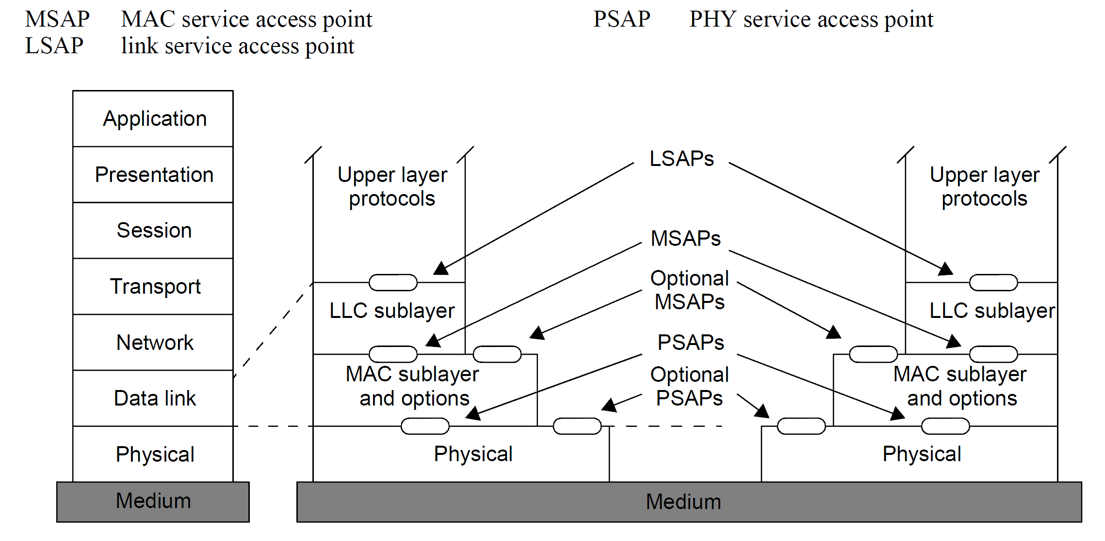
Physical Layer IEEE 802-2014 Reference models
IEEE Std 802-2014 OVERVIEW AND ARCHITECTURE
IEEE 802 Reference Model (RM) for end stations

Slide 35
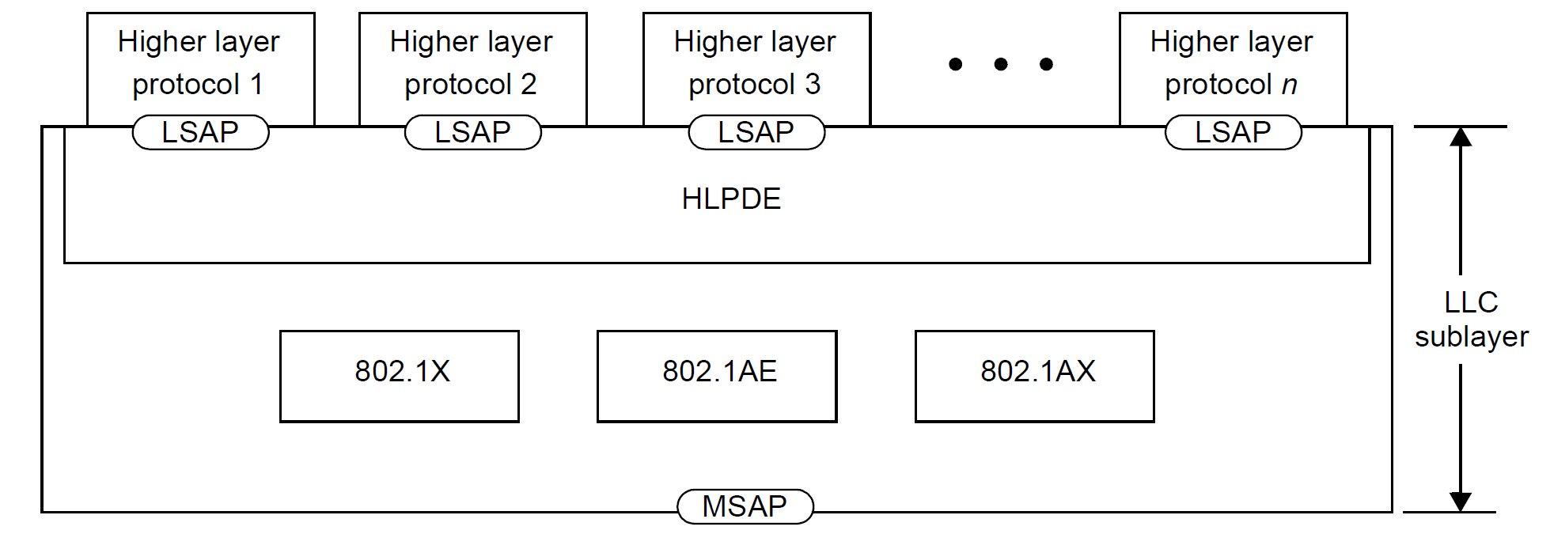
IEEE 802-2014 Reference Model description for end stations
LLC sublayer in 802 Reference Model

Slide 36
Data Link Layer Standards ISO/IEC 8802-2 (IEEE 802.2) logical link control
LSAP(Link Service Access Point) :
The logical concatenation of the LLC address field and the MAC address field
Identifiers for Upper layers
LLC address field
LLC address with SNAP (Subnetwork Access Protocol) (IEEE 802.11)
LLC: 0xAAAA03; DSAP-SSAP-Control (0xAA/AB = SNAP identifier)
SNAP: Protocol identifier (5octets);
an OUI field (3octets:00-00-00) and an Ethertype field (2octets)
Ethertype (IEEE 802.3)

Slide 37
IEEE 802-2014 Reference Model description for end stations
Higher Layer Protocol Discrimination Entity (HLPDE)
EtherType protocol discrimination (EPD)
Ethertype
LLC protocol discrimination (LPD)
LLC address field
LLC address with SNAP (Subnetwork Access Protocol)
Each IEEE 802 standard describes the HLPDE.

Slide 38
Data Link Layer IEEE 802-2014
IEEE 802 networks use frame-based communications over a variety of media to connect various digital apparatus regardless of computer technology and data type
The basic communications capabilities provided by all IEEE 802 standards are frame based with source and destination addressing and asynchronous timing (no common clock)
In a frame-based system, the format is a variable-length sequence of data octets.
Apparatus [명사] 기구, 장치

Slide 39
IEEE 802-2014 Reference Model description for end stations
The MAC sublayer performs the functions necessary to provide frame-based, connectionless-mode‌ data transfer between stations in support of the LLC sublayer for networks that support it

Slide 40
IEEE 802-2014 Reference Model description for end stations
The principal functions of the MAC sublayer
Frame delimiting and recognition
Addressing of destination stations (both as individual stations and as groups of stations)
Conveyance of source-station addressing information
Transparent data transfer of PDUs from the next higher sublayer
Protection against errors, generally by means of generating and checking frame check sequences
Control of access to the physical transmission medium

Slide 41
IEEE 802-2014 Reference Model description for end stations
MAC entities use their respective PHY entities to exchange bits with their peers.
The PHY provides the capability to transmit and receive modulated signals assigned to specific frequency channels for broadband or wireless media or to a single baseband-channel.

Slide 42
IEEE 802-2014 Reference Model description for end stations
The PHY service offered to the MAC sublayer is expressed as the transfer of bits (in sequences representing MAC frames)
The symbols [that are encoded for transmission] do not always represent individual bits.
Symbol:
It is the basic unit of transmitted modulated signal at the PHY.
It usually contains several data bits.

Slide 43
Common Interconnection and interworking with several links or networks
PHY interconnection
Repeaters: extending the distance of a link by connection two segment links.
MAC interconnection
Bridges: extending the coverage of a local area network
Network-layer inter-networking
Routers: extending the coverage of a network layer consisting of several networks.

Slide 44
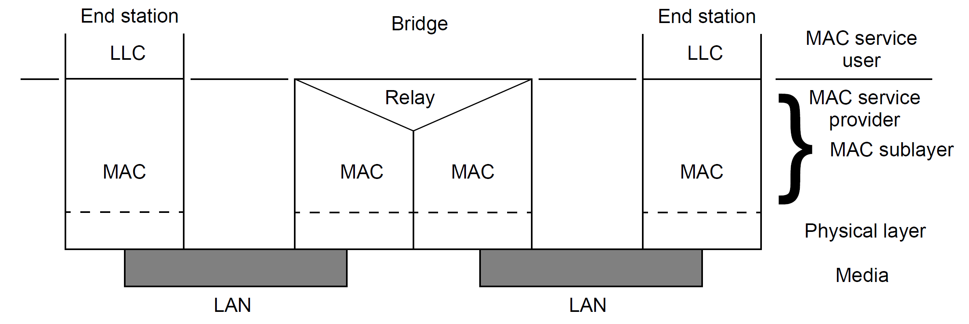
IEEE 802-2014 MAC-sublayer interconnection: Bridges
Internal organization of the MAC sublayer with bridging

Slide 45
Data Link Layer Standards
ISO/IEC 8802-2 Logical Link Control

Slide 46
Data Link Layer Standards ISO/IEC 8802-2 Logical Link Control
The ISO/IEC 8802-2:1998 standard
define Logical Link Control (LLC) as the upper portion of the data link layer of the OSI Model
The LLC provides a uniform interface to the user of the data link service, usually the network layer.

Slide 47
Data Link Layer Standards ISO/IEC 8802-2 Logical Link Control
This International Standard describes the functions, features, protocol, and services of the Logical Link Control (LLC) sublayer in the ISO/IEC 8802 LAN Protocol
The LLC sublayer constitutes the top sublayer in the data link layer
It is common to the various medium access methods (MAC) that are defined and supported by the ISO/IEC 8802 activity

Slide 48
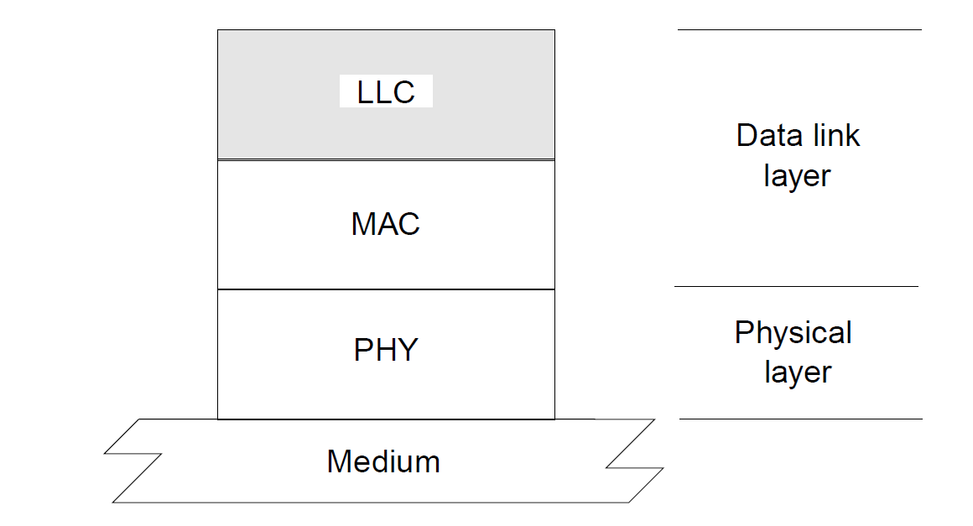
Data Link Layer Standards ISO/IEC 8802-2 Logical Link Control

Slide 49
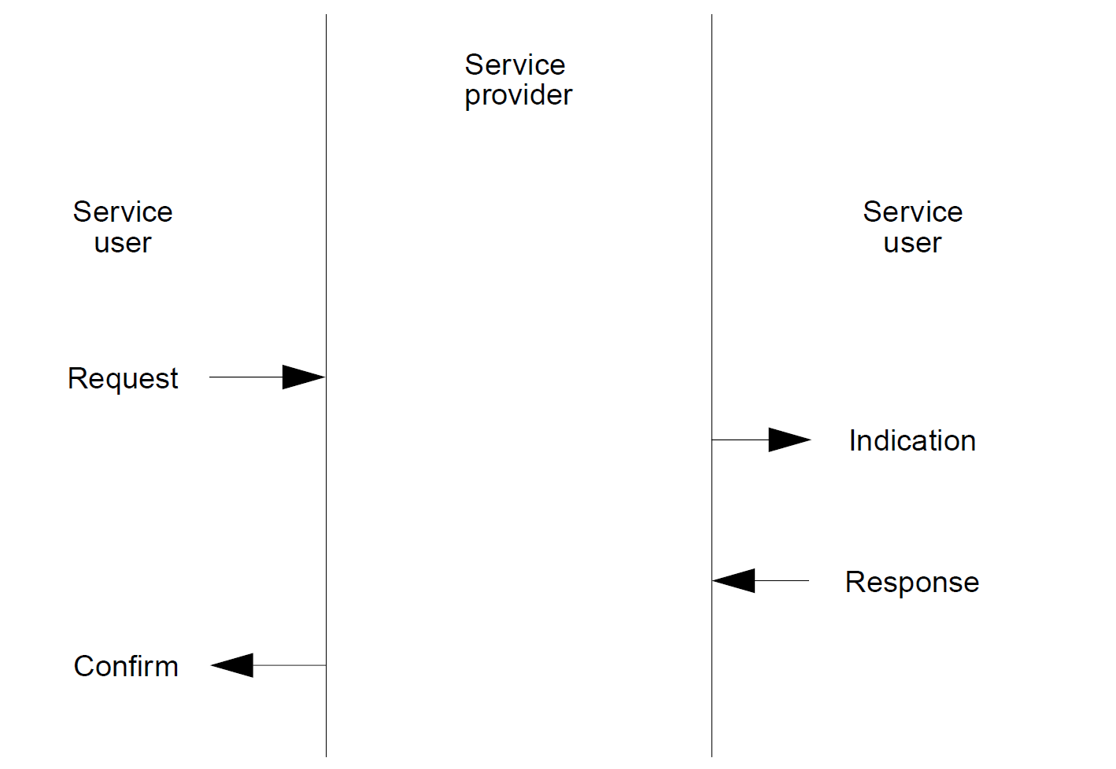
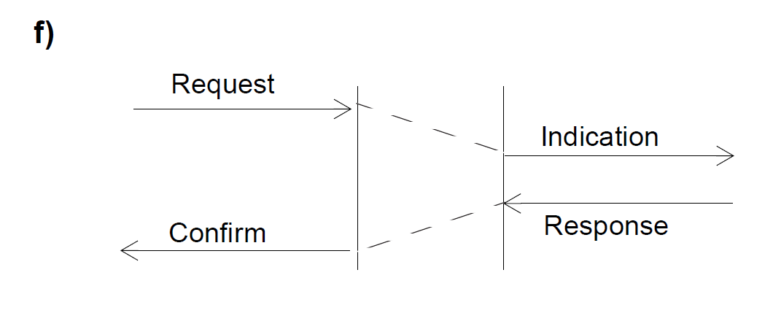
Data Link Layer Standards ISO/IEC 8802-2 Logical Link Control
Service primitives
Time-sequence diagrams

Slide 50
Data Link Layer Standards ISO/IEC 8802-2 Logical Link Control
Three forms of service
Unacknowledged connectionless-mode services
Connection-mode services
Acknowledged connectionless-mode services

Slide 51
Data Link Layer Standards ISO/IEC 8802-2 Logical Link Control
Unacknowledged connectionless-mode services
This set of data transfer services provides the means by which network entities can exchange link service data units (LSDUs) without the establishment of a data link level connection.
The data transfer can be point-to-point, multicast, or broadcast

Slide 52
Data Link Layer Standards ISO/IEC 8802-2 Logical Link Control
Connection-mode services
This set of services provides the means for establishing, using, resetting, and terminating data link layer connections
These connections are point-to-point connections between LSAPs.

Slide 53
Data Link Layer Standards ISO/IEC 8802-2 Logical Link Control
Connection-mode services
connection establishment service
connection termination service
connection reset service
connection-oriented data transfer service
This service also provides data link layer sequencing, flow control, and error recovery
connection flow control service

Slide 54
Data Link Layer Standards ISO/IEC 8802-2 Logical Link Control
Acknowledged connectionless-mode services
The acknowledged connectionless-mode data unit exchange services provide the means by which network layer entities can exchange link service data units (LSDUs) that are acknowledged at the LLC sublayer, without the establishment of a data link connection.
The data unit transfer is point-to-point

Slide 55
Data Link Layer Standards ISO/IEC 8802-2 Logical Link Control
Data Transfer Primitives for Network Layer
Unacknowledged connectionless-mode data transfer
DL-UNITDATA.request
DL-UNITDATA.indication
Connection-mode data transfer
DL-DATA.request
DL-DATA.indication
Acknowledged connectionless-mode data transfer
DL-DATA-ACK.request
DL-DATA-ACK.indication
DL-DATA-ACK-STATUS.indication

Slide 56
Data Link Layer Standards ISO/IEC 8802-2 Logical Link Control
DL-UNITDATA.request/indication parameters
source_address
the local LSAP
LSAP(Link Service Access Point) : the logical concatenation of the MAC address field and the LLC address field
destination_address
the remote LSAP
either an individual or group address
Data
the link service data unit to be transferred by the data link layer entity
Priority
the priority desired for the data unit transfer

Slide 57
Data Link Layer Standards ISO/IEC 8802-2 Logical Link Control
Primitives for the MAC sublayer
MA-UNITDATA.request
MA-UNITDATA.indication
MA-UNITDATA-STATUS.indication

Slide 58
Data Link Layer Standards ISO/IEC 8802-2 Logical Link Control
MA-UNITDATA.request/indication
source_address
an individual MAC sublayer entity address
destination_address
either an individual or a group MAC sublayer entity address
routing_information
the route desired for the data unit transfer (source-routing only – token ring)
Data
Priority
service_class
the class of service desired for the data unit transfer

Slide 59
Data Link Layer Standards IEEE 802.1AC-2016
IEEE 802.1AC-2016
Media Access Control (MAC) Service Definition
It defines the Internal Sublayer Services
It also defines mapping parameters between the ISS MSAP and the MSAP of each media dependent standards (IEEE 802.3, IEEE 802.11, etc).
The MAC service definition was first standardized as ISO/IEC 15802-1:1995

Slide 60
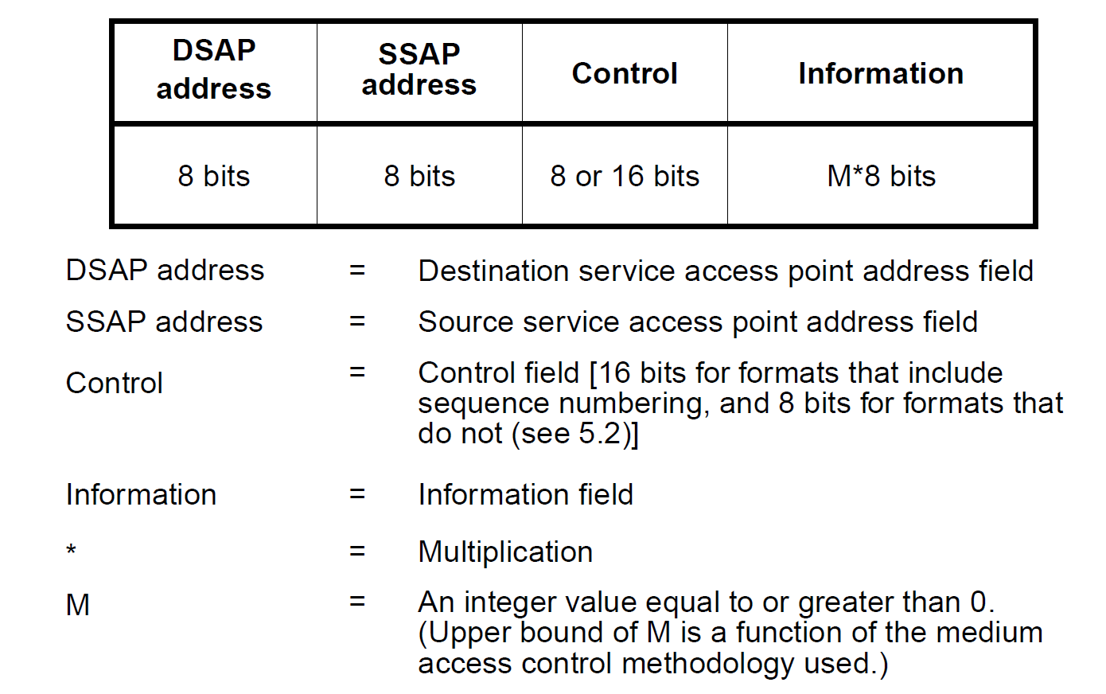
Data Link Layer Standards ISO/IEC 8802-2 LLC Protocol Data Unit (PDU)

Slide 61
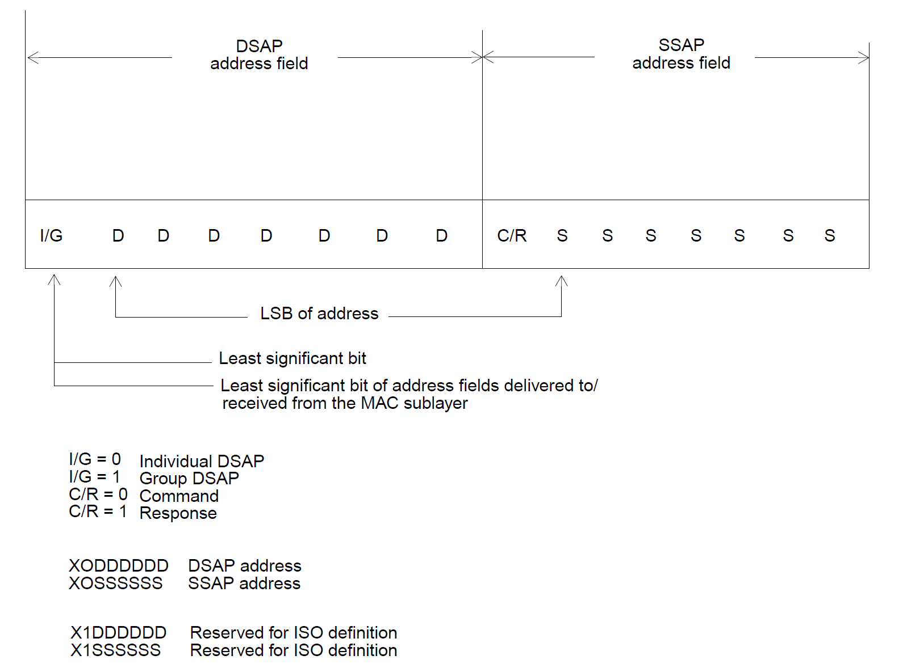
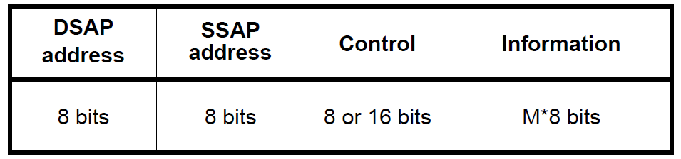
Data Link Layer Standards ISO/IEC 8802-2 LLC PDU LLC address field
DSAP | SSAP=0xAAAA
10101010 10101010
I/G=(0)Individual DSAP
C/R=(0)Command

Slide 62

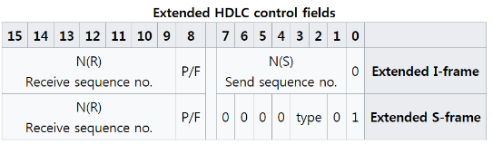
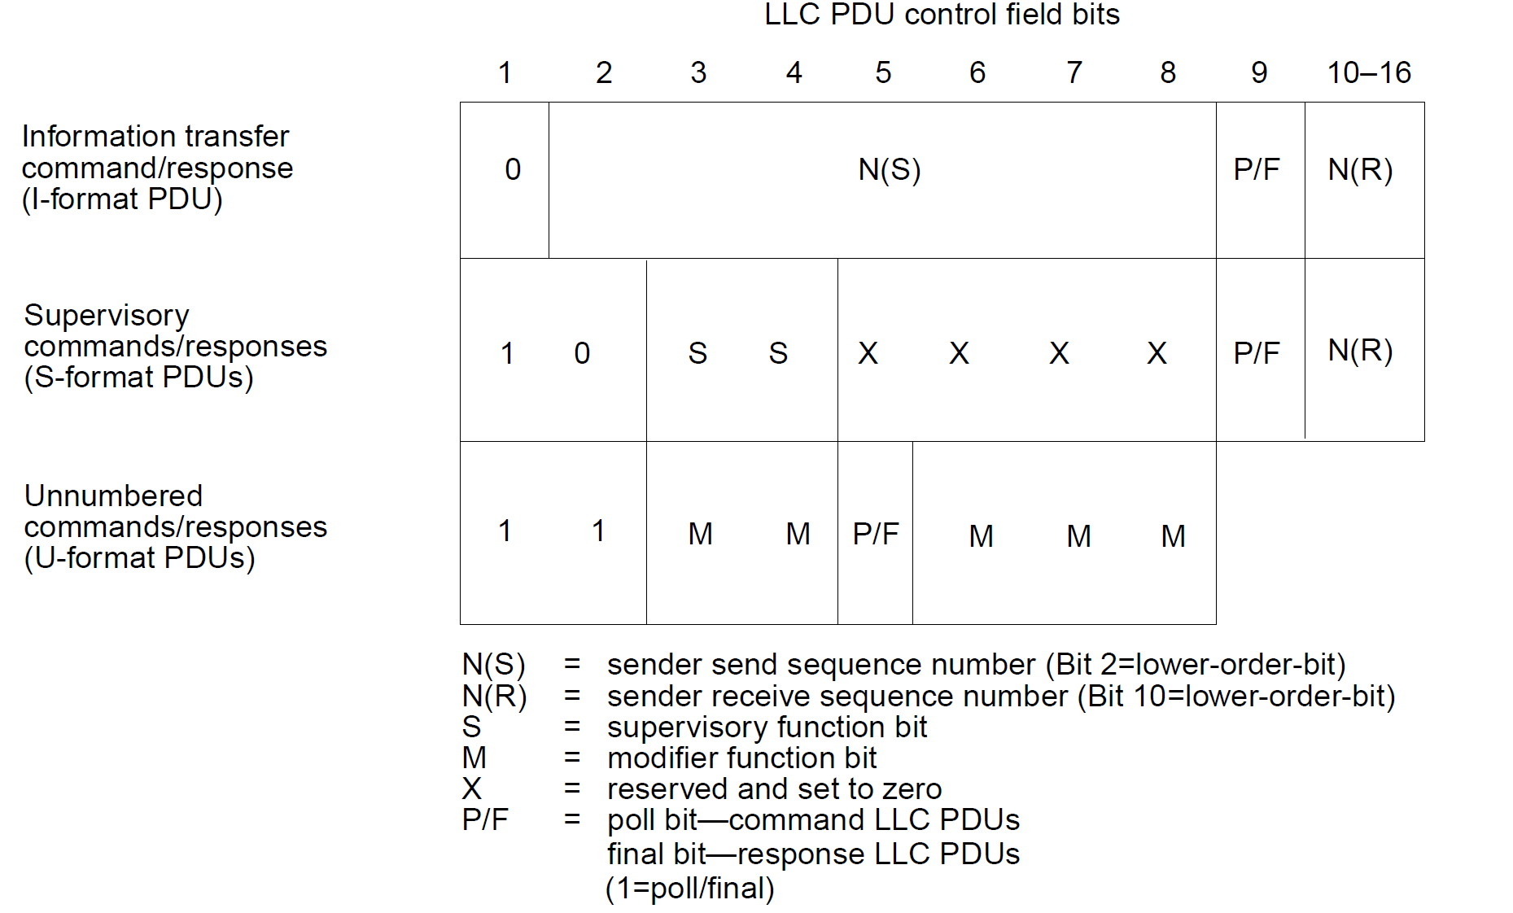
Data Link Layer Standards ISO/IEC 8802-2 LLC PDU LLC Control field

Slide 63
Data Link Layer Standards MAC Sublayer Standards
IEEE 802.3 and IEEE 802.11 MAC frames

Slide 64
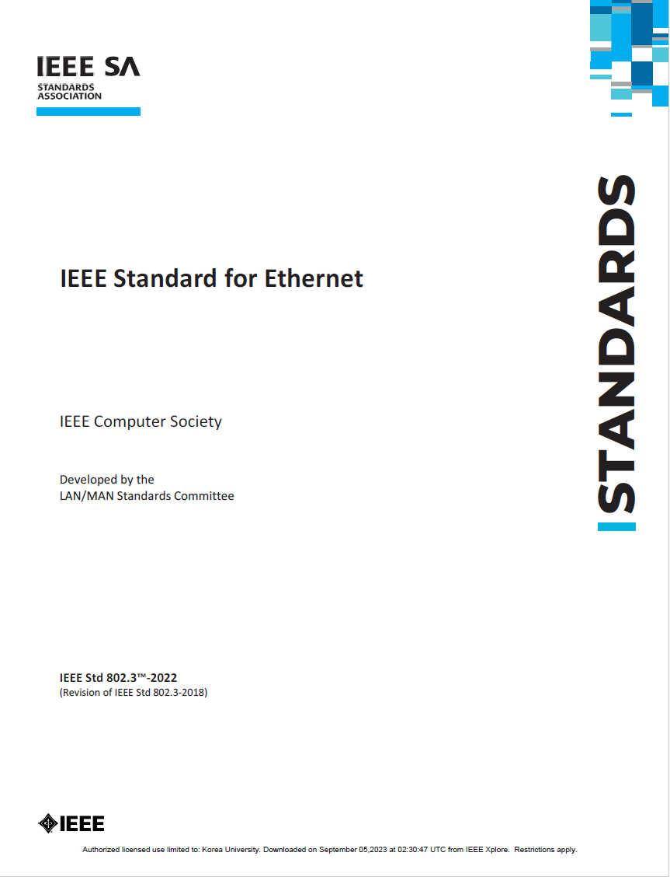
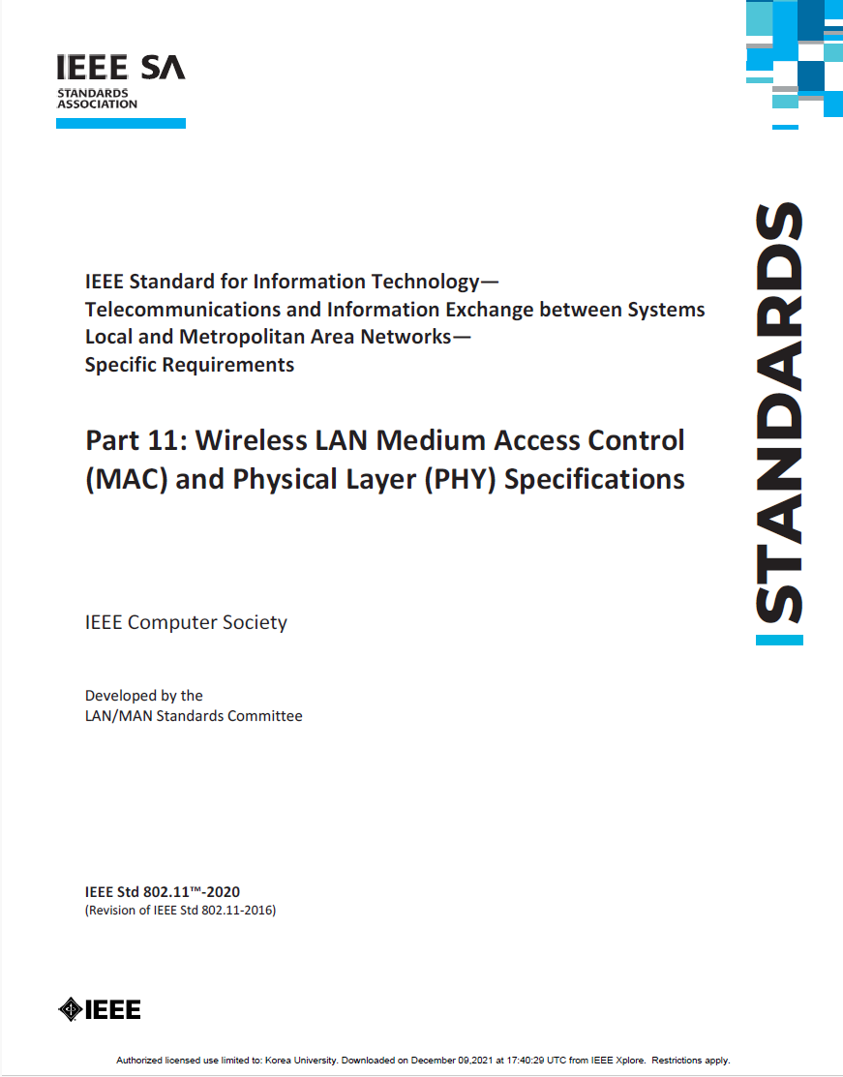
MAC Sublayer Standards MAC sublayers : Wired and Wireless LAN

Slide 65
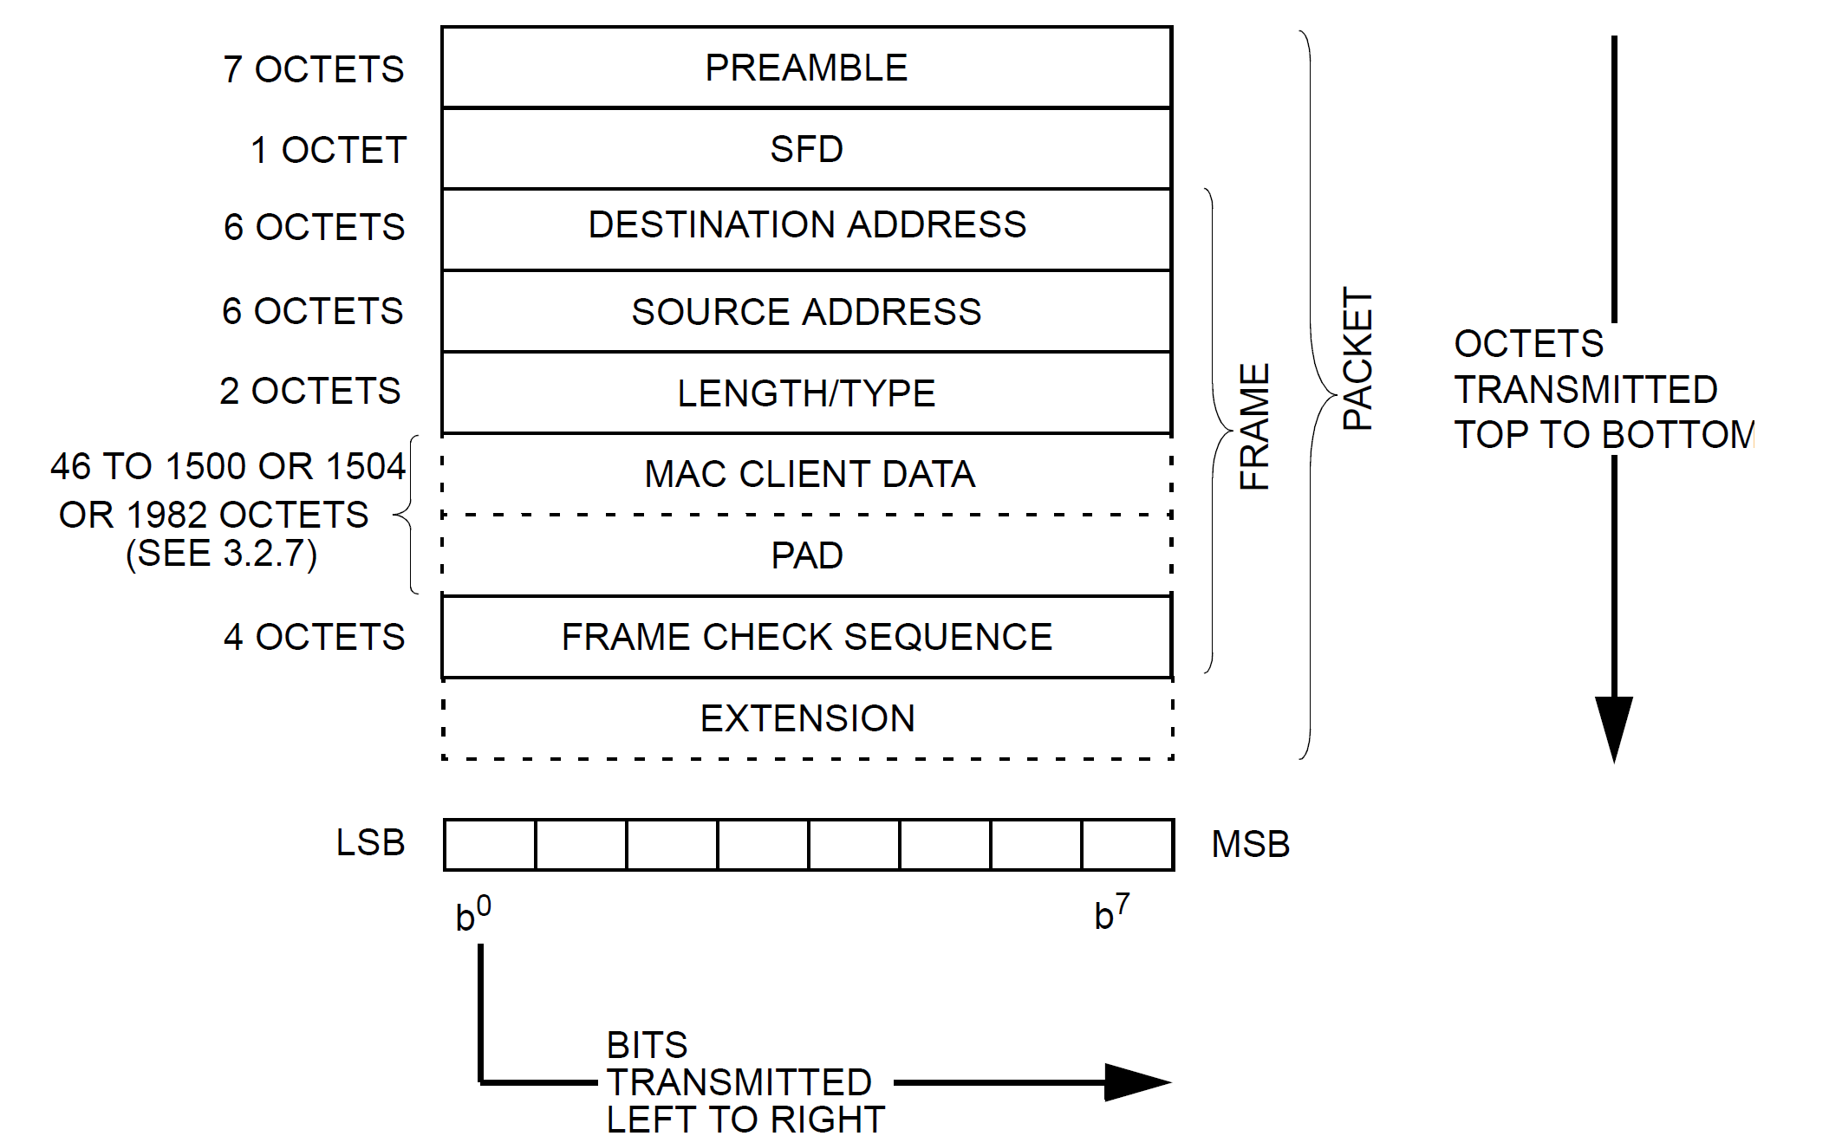
MAC Sublayer Standards 802.3-2022 Ethernet 3.1.1 Packet format
46 : minFrameSize (64 octets) – (DA+SA+Length/Type+FCS)
1500 decimal—basic frames
1504 decimal—Q-tagged frames
1982 decimal—envelope frames
Figure 3–1—Packet format

Slide 66
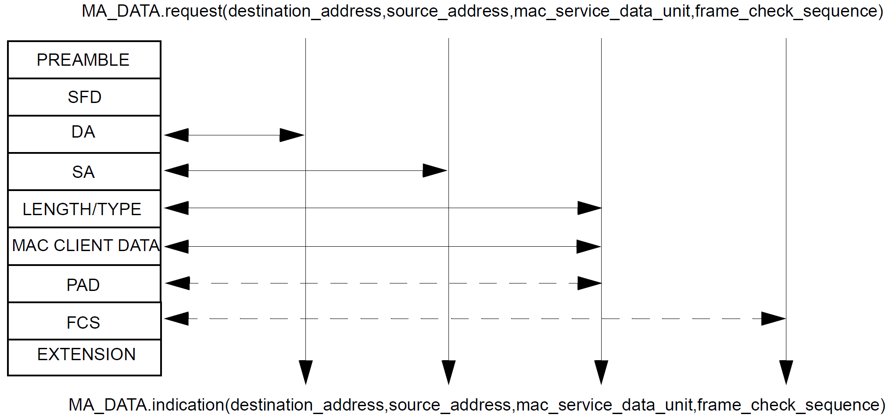
MAC Sublayer Standards 802.3-2022 Ethernet 3.1.2 Service interface mappings
Figure 3–2—Service primitive mappings

Slide 67
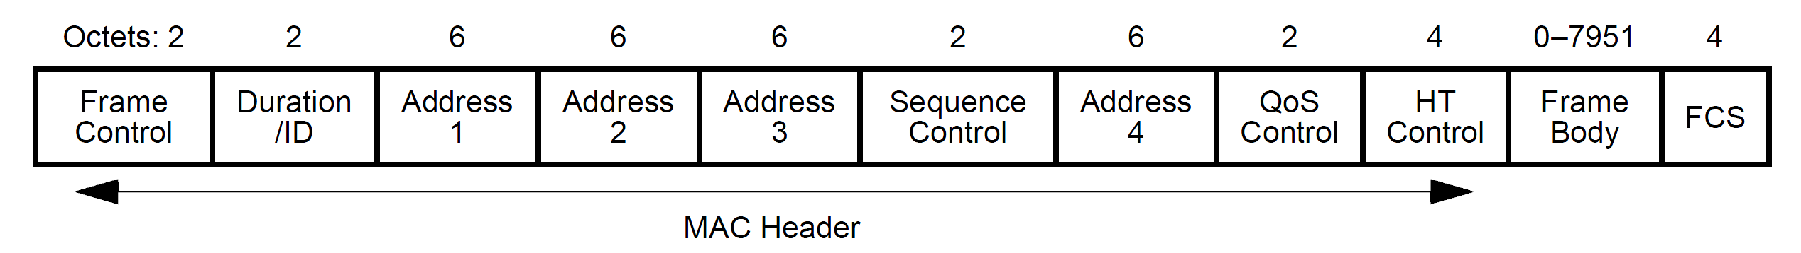
MAC Sublayer Standards 802.11-2020 WLAN
Genera MAC frame format

Slide 68
The summary of DLL/MAC frames HDLC, 802.3/Ethernet, 802.11
Address
Control
SDU
PPP[Protocol/SDU]
FCS
DA
SA
(Length)/Type
SDU
PAD
FCS
MAC Frame
DSAP
SSAP
CTL
SNAP
[000000/Type]
SDU
LLC Frame (802.2 Frame )
FC
Duration
A1
A2
A3
Sequence
Control
A4
QoS
Control
HT
Control
SDU
FCS
HDLC | IEEE 802.3 frame | IEEE 802.11 frame
I-frame | N/A (only connectionless) | N/A
S-frame | N/A (no flow control & error correction) | Control frame (no flow control)
U-frame | Management frame | Management frame (N/A)
UI-frame | MAC frame | Data frames
Control Field: Frame Type(bit0 or bit[1..0]) | N/A | Type subfield of Frame Control field (Type bit[3..2])
Control Field: Frame sequence | N/A | Sequence Control
Control Field: Poll/Final | N/A | Control frame (QoS +Poll)
Upper Layer Identifier: Not in HDLC (Protocol field of PPP frame) | Ethertype | LLC/SNAP (Ehthertype)
Peer entity address: address field (DA or SA) | DA field (and SA field for a response frame) | DA field (and SA field for a response frame)

